Slide 1
Confidentiality
By reviewing this presentation or participating in a SRC event, you are agreeing not to use the presented information for purposes unrelated to the event until approved by SRC;
Material may be presented that represents current research, some of which has not been published or protected. This material is not for public disclosure and until potential IP rights have been protected, please treat all of the information presented as confidential information which is the property of the researcher and their university.

Slide 2
Novel Super-Resolution and MIMO Techniques for Automotive and Emerging Radar Applications
Murat Torlak, UT Dallas
SRC Task 2712.029

Slide 3
Novel Super-Resolution and MIMO Techniques for Automotive and Emerging Radar Applications 2712.029, Murat Torlak, University of Texas at Dallas
Technical Thrust: Analog/Mixed-Signal Circuits, Systems, and Devices (AMS-CSD)
Task Leader: Murat Torlak, Professor, University of Texas at Dallas
Industrial Liaisons: Dan Wang (Texas Instruments)
Anticipated Results: Algorithms which utilize the hardware efficiently and produce robust estimation of high resolution radar images in complex environments.
Task Description: Develop novel super-resolution and MIMO techniques to achieve high-performance and low complexity for automotive and emerging radar applications.
Task Deliverables: (1) Development of mathematical models of the proposed robust and low complexity high resolution imaging techniques and their software implementation (2) MIMO mathematical models and software implementation
Start Date: Aug. 2017

Slide 4
Students on Task 2712.029
Graduated Students and Current Affiliation
Dr. Muhammet Emin Yanik, May 2020
Current Students and Anticipated Graduation Date
Ashwin Bhobani Baral, Aug 2021
Bhaskar Raj Upadhyay, Aug 2022
Josiah Wayland Smith, Aug 2022
Internships and Full-Time Offers
Muhammet Emin Yanik, TI, Full-time (Jan’20)
Josiah Wayland Smith, Imec, Internship, Sum’20

Slide 5
Executive Summary
Accomplishments during the past year
Completed 2D mmWave Fast SAR imager
Developed 3D MIMO-ISAR imaging testbed/algorithms
Developed vital sign monitoring algorithms
Future direction – highlighting changes
Development of real-time MIMO algorithms for increasing detection and tracking accuracy in dynamic time-variant and multipath environments
Demonstration of mm-Wave radar technology in-home monitoring/fall detection and for video game players

Slide 6
Motivation and Agenda
mmWave imaging technology is one of the fastest growing technologies of this decade with wide range of applications.
Security screening, Vital sign monitoring, Gesture recognition,
Automotive radars, Smart homes, UAV radars and imaging
Application I: mmWave MIMO-ISAR Imaging prototype
System model and algorithms
Based on TI 77 GHz mmWave radar sensors
Mechanical scanner
Experimental Results
Application II: Vital Sign Detection
Algorithms verified via pendulum/speakers
Pilot experiments
Publications/Ongoing Work and Future Directions

Slide 7
Application I MIMO-ISAR Imager
Josiah Smith

Slide 8
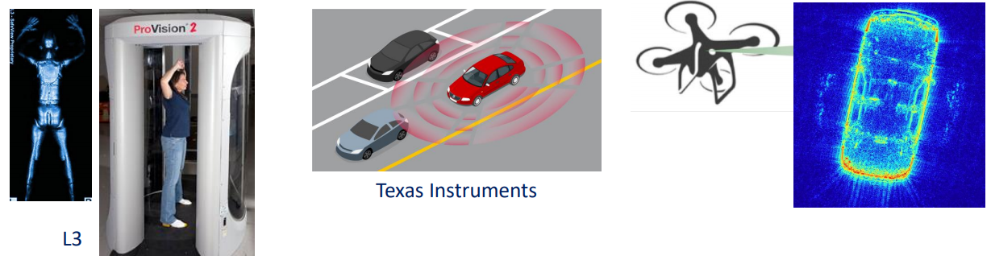

Motivation – mmWave Imaging
Millimeter-wave imaging sensors have a large application space including security sensing, automotive radar, high-resolution imaging, and many more!
Goal: Construct a high resolution mmWave imaging system for holographic 3-D image reconstruction using ISAR techniques and commercially available mmWave radar sensors
Approach: Develop an efficient Fourier-based algorithm for MIMO-ISAR image reconstruction and build an x-y-$θ$ mechanical scanner to synthesize both rectangular and cylindrical apertures.
Notes:
Millimeter-wave sensors have recently emerged as a promising solution to a variety of sensing problems in the arenas of security sensing, automotive radar, high-resolution imaging, and more. Additionally, millimeter-wave radar devices are becoming increasingly affordable due to advancements in system-on-chip RF integrated circuit technology.
The goal of this work is to construct a high resolution mmWave imaging system for holographic 3-D image reconstruction using ISAR techniques and commercially available mmWave radar sensors.
To accomplish this goal, we develop an efficient Fourier-based algorithm for MIMO-ISAR image reconstruction and build a three-dimensional mechanical scanner to synthesize both rectangular and cylindrical apertures.

Slide 9
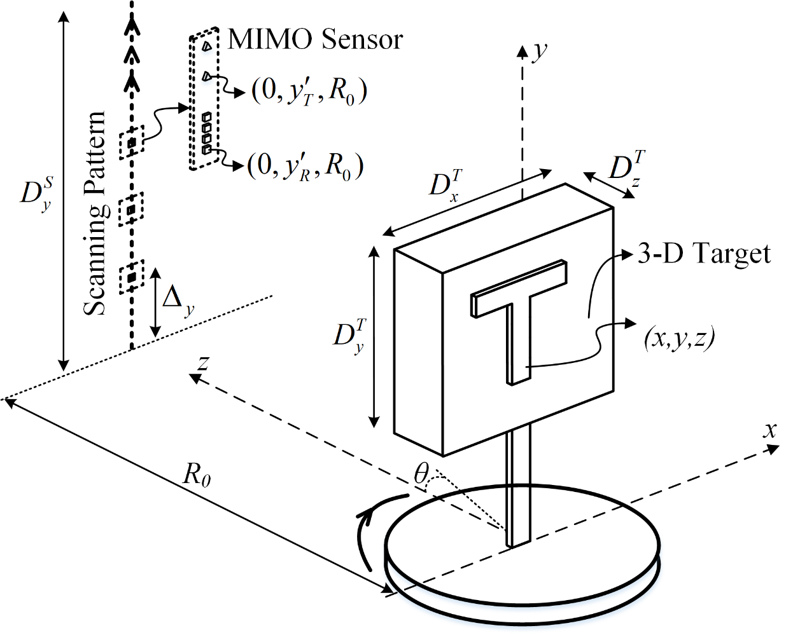
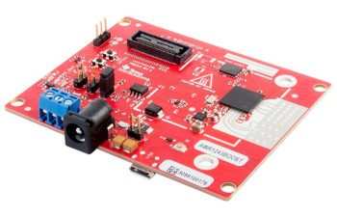

MIMO-ISAR System Configuration
Move the radar along the y-axis
Rotate the target at constant radial distance $R_{0}$ from radar
TI mmWave radar (IWR1443Boost)
2 Tx, 4 Rx channels
8 channel colinear multistatic-MIMO virtual array
Notes:
Our system consists of three main components: a linear vertical scanner, rotator, and FMCW radar. The linear mechanical scanner moves the radar along the y-axis up and down. The target is mounted to the rotator, which rotates the target at a constant radial distance (R naught) from the radar scanning plane. The target coordinates are in (x, y, z) and the position of each element in the synthetic aperture are at the points (R naught cosine theta, y’, R naught sine theta) in (x, y, z) space. Lastly, we will use a TI mmWave radar with 2 Tx and 4 Rx channels resulting in an 8-channel colinear multistatic-MIMO virtual array.

Slide 10
MIMO-ISAR Scanning
Notes:
Even though the multistatic MIMO array can be approximated by a virtual array of elements at the midpoint of each Tx/Rx pair, the multistatic nature of the MIMO radar introduces phase errors compared to the virtual monostatic array.
However, for small distances between Tx and Rx elements, these errors can be somewhat compensated for using a phase correction known in the literature and expressed below. This multistatic-to-monostatic conversion enables the use of spatially efficient MIMO arrays and computationally efficient monostatic image reconstruction algorithms.

Slide 11
MIMO-ISAR Scanning
Notes:
Even though the multistatic MIMO array can be approximated by a virtual array of elements at the midpoint of each Tx/Rx pair, the multistatic nature of the MIMO radar introduces phase errors compared to the virtual monostatic array.
However, for small distances between Tx and Rx elements, these errors can be somewhat compensated for using a phase correction known in the literature and expressed below. This multistatic-to-monostatic conversion enables the use of spatially efficient MIMO arrays and computationally efficient monostatic image reconstruction algorithms.

Slide 12
MIMO-ISAR Scanning
Notes:
Even though the multistatic MIMO array can be approximated by a virtual array of elements at the midpoint of each Tx/Rx pair, the multistatic nature of the MIMO radar introduces phase errors compared to the virtual monostatic array.
However, for small distances between Tx and Rx elements, these errors can be somewhat compensated for using a phase correction known in the literature and expressed below. This multistatic-to-monostatic conversion enables the use of spatially efficient MIMO arrays and computationally efficient monostatic image reconstruction algorithms.

Slide 13
MIMO-ISAR Scanning
Notes:
Even though the multistatic MIMO array can be approximated by a virtual array of elements at the midpoint of each Tx/Rx pair, the multistatic nature of the MIMO radar introduces phase errors compared to the virtual monostatic array.
However, for small distances between Tx and Rx elements, these errors can be somewhat compensated for using a phase correction known in the literature and expressed below. This multistatic-to-monostatic conversion enables the use of spatially efficient MIMO arrays and computationally efficient monostatic image reconstruction algorithms.

Slide 14
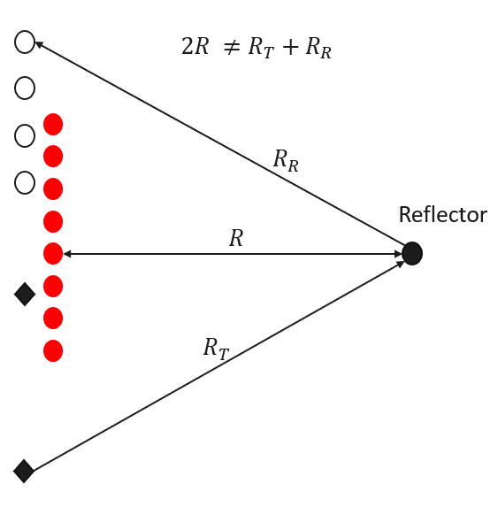
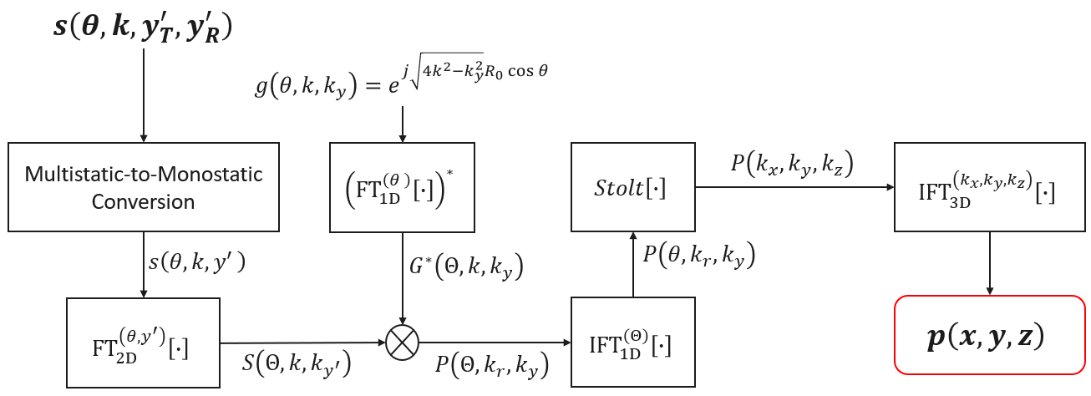
Multistatic-to-Monostatic Conversion
Multistatic MIMO array introduces phase errors
$$s_{mult}\left(y_{T}^{′},y_{R}^{′},k\right)=σe^{jk(R_{T}+R_{R})}$$
$$s_{mono}\left(y,k\right)=σe^{jk2R}$$
Real multistatic Tx
Real multistatic Rx
Virtual monostatic Tx/Rx
Phase correction ${s_{mono}\left(y,k\right)= s}_{mult}\left(y_{T}^{′},y_{R}^{′},k\right)e^{−jk\frac{d_{y}^{2}}{4R_{0}}}$
Notes:
Even though the multistatic MIMO array can be approximated by a virtual array of elements at the midpoint of each Tx/Rx pair, the multistatic nature of the MIMO radar introduces phase errors compared to the virtual monostatic array.
However, for small distances between Tx and Rx elements, these errors can be somewhat compensated for using a phase correction known in the literature and expressed below. This multistatic-to-monostatic conversion enables the use of spatially efficient MIMO arrays and computationally efficient monostatic image reconstruction algorithms.

Slide 15
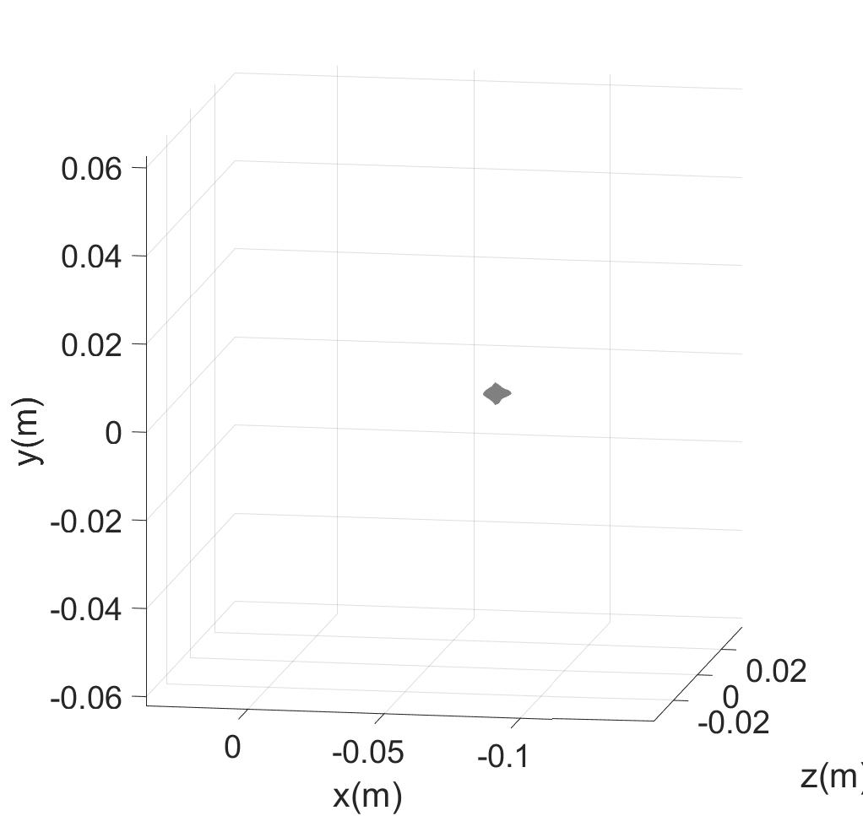
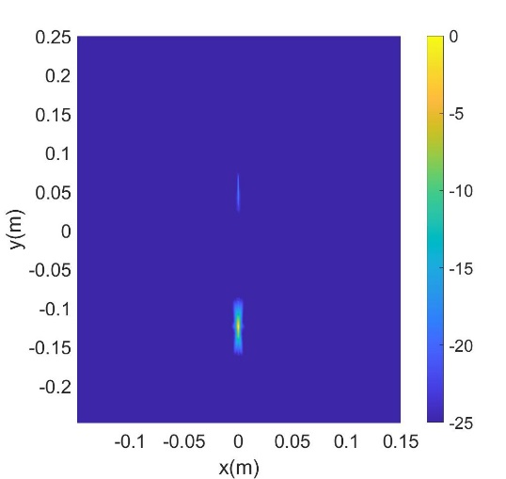
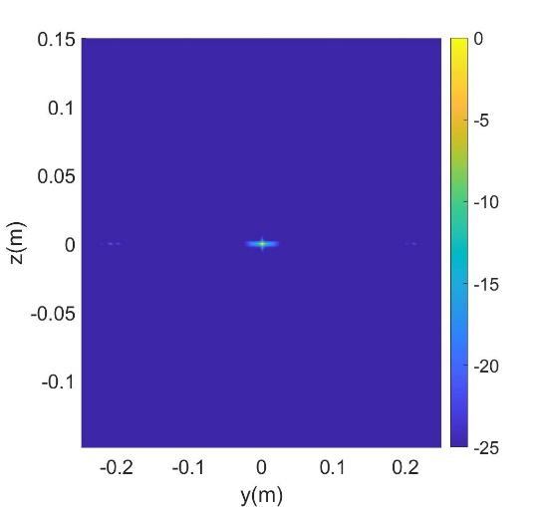
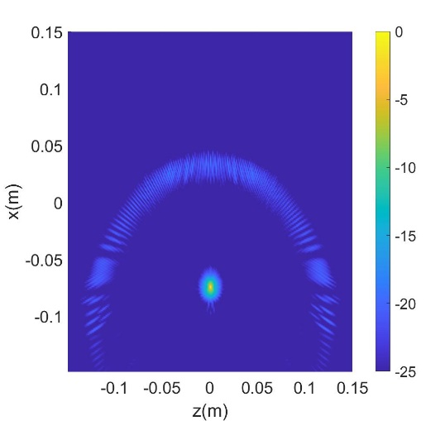
3-D PSF - Simulated
(x-y) PSF
(y-z) PSF
Reconstructed PSF
(x-z) PSF

Slide 16
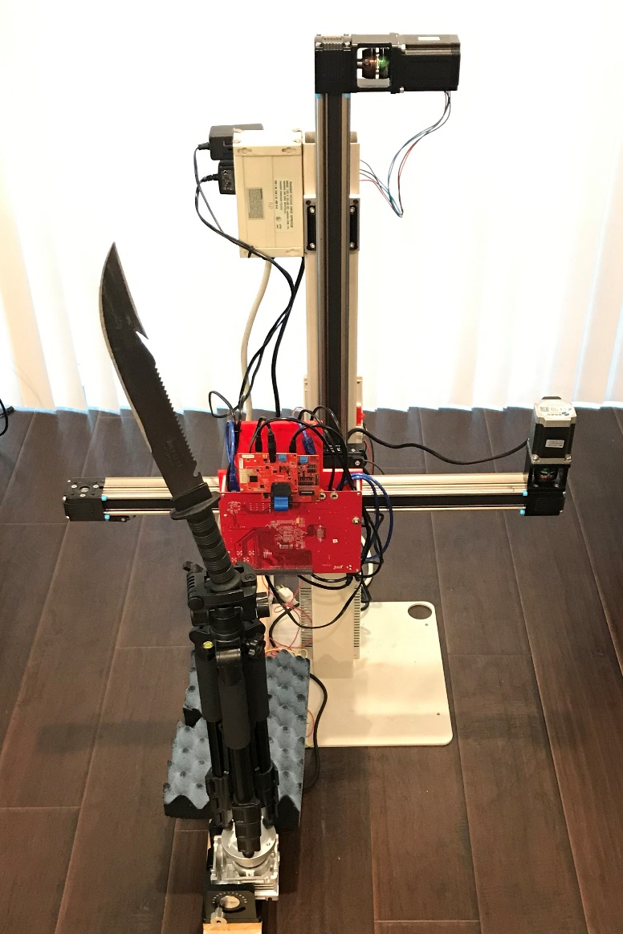
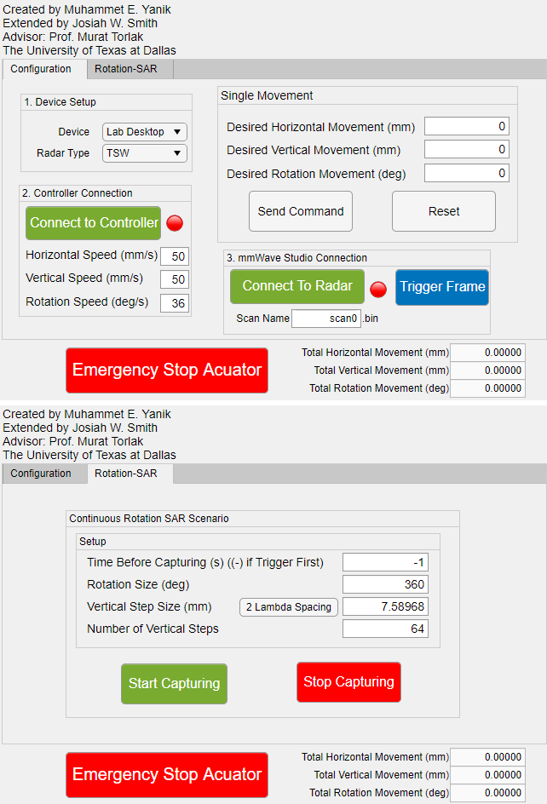
System Setup
x-y-$θ$ mechanical scanner capable of synthesizing rectangular and cylindrical apertures.
Compare rectangular SAR and rotational ISAR
Microcontroller and radar controlled by MATLAB
Vertical Scanner
Notch
TI Radar
Setup Radar
Control Scan
Horizontal Scanner
Rotator
Serrated edge
Notes:
Finally, we assemble a fully integrated system with vertical, horizontal, and rotation scanning capabilities allowing for comparison between rectangular SAR and rotational ISAR. The entire scanner is controlled through a custom-built MATLAB graphical user interface that sets up the radar device and controls the scan.
We will proceed to reconstruct high resolution holographic images of the knife shown to the right. Note the notch and serrated edge of the blade, which will be visible in the subsequent images.

Slide 17
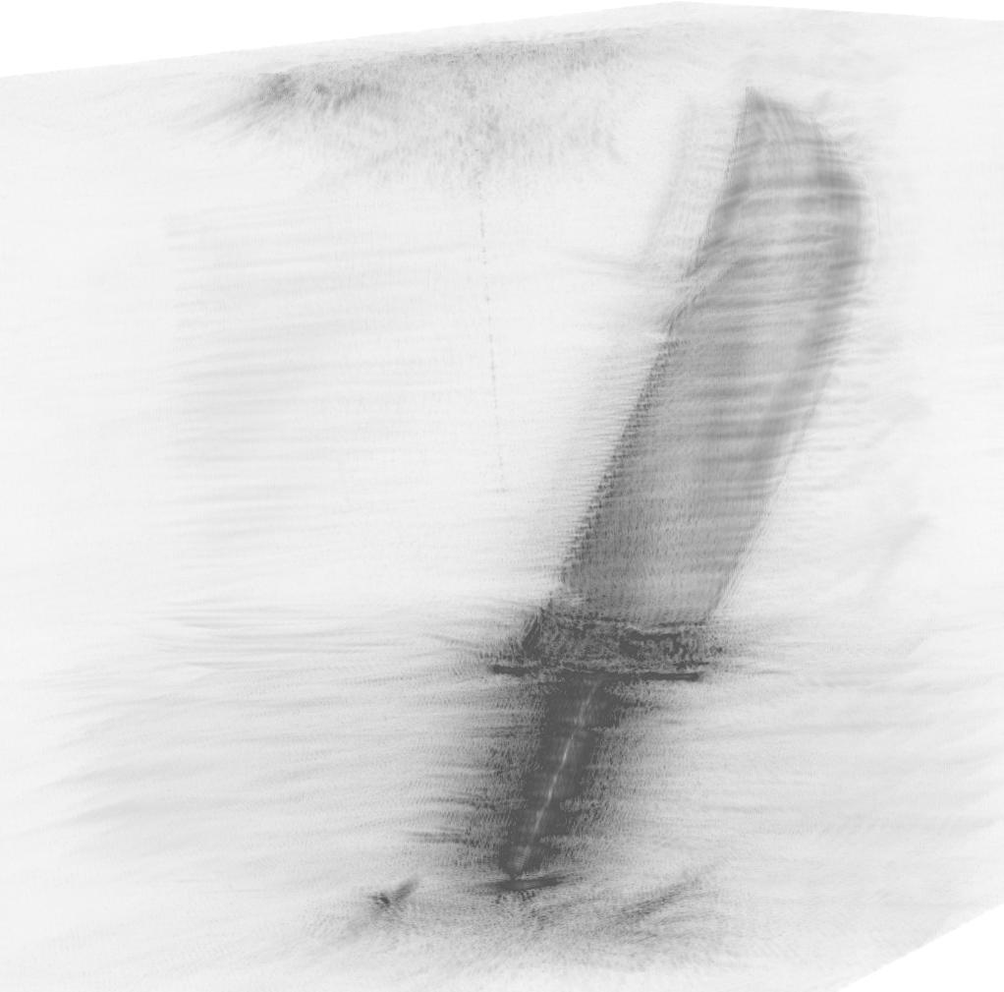
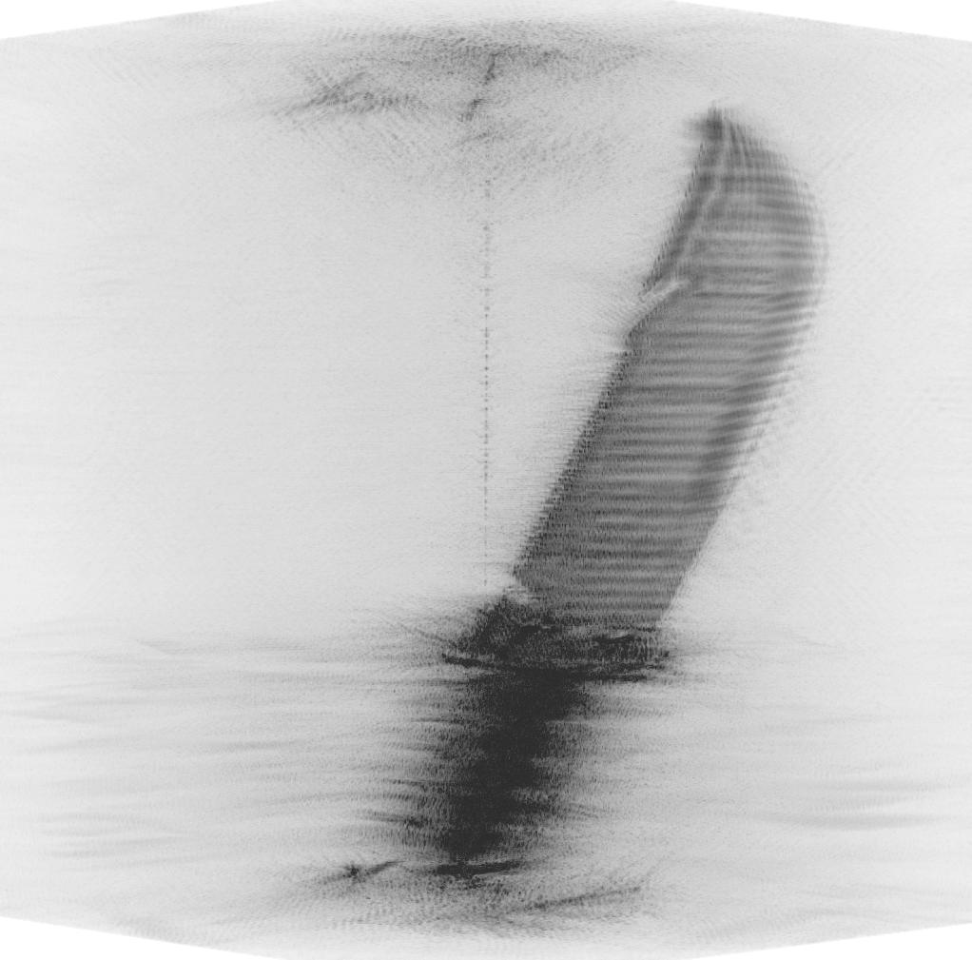
Rotational ISAR – Imaging Results
Cylindrical SISO Array
512 quasi-monostatic vertical elements
137 min per scan
Cylindrical MIMO Array
512 multistatic virtual vertical elements
17 min per scan
Notes:
We first compare images from a SISO array of 512 quasi-monostatic vertical elements spaced by a quarter wavelength. To scan at each of the 512 vertical locations, the entire scan took 137 minutes to complete. In contrast, the scan using a MIMO array of the same size took 17 minutes in total. Both the images show a high-quality reconstruction of the knife blade with the notch and serrated edge visible.

Slide 18
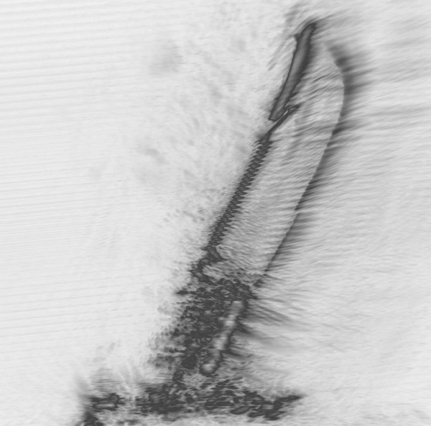
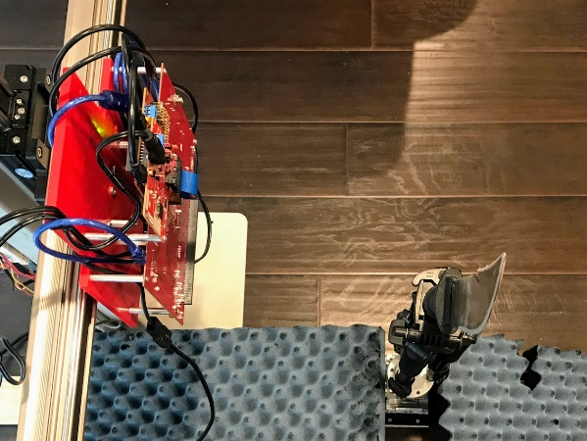
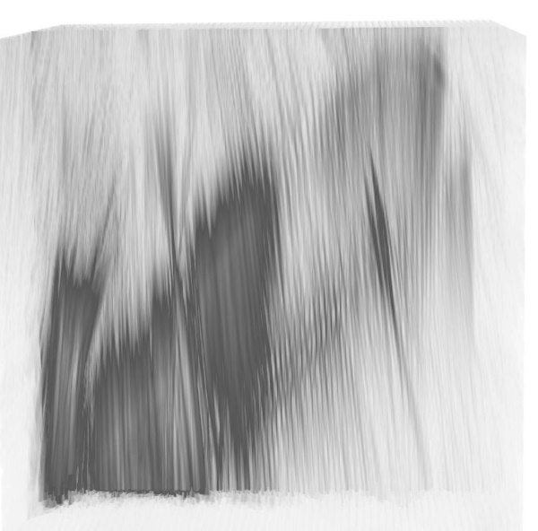
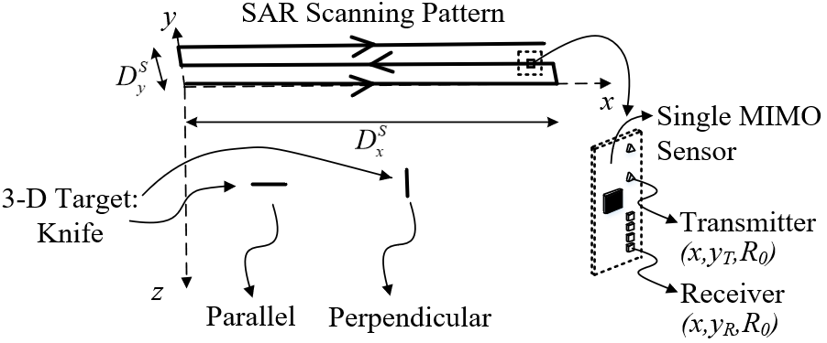
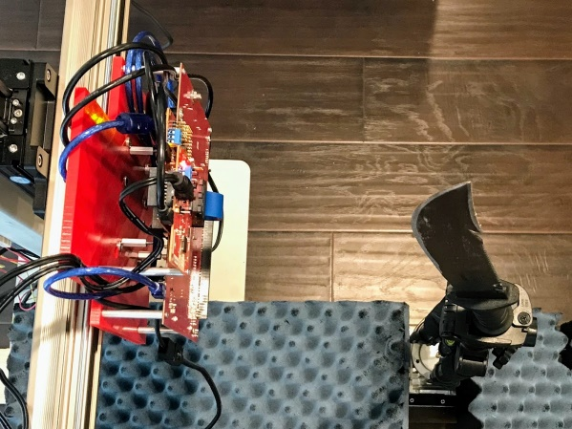
Rectangular SAR – Imaging Results
2-D scan over x-y plane
29 min per scan
Reconstruct 3-D image
Performs well when target is parallel to aperture plane
Suffers in nonideal conditions
Parallel
Perpendicular
Notes:
Next, we use the 2-D horizontal and vertical scanning axes to produce 3-D holographic images from a rectangular SAR aperture. We consider multiple cases, 1) the knife blade is parallel with the x-y aperture plane, and 2) the knife blade is perpendicular to the x-y plane. The orientation of the knife with respect to the scanner has substantial implications on the image quality.
The images on the right compare the reconstructed images of the knife blade when the knife is parallel and perpendicular to the scanning plane.

Slide 19


Rotational ISAR vs. Rectangular SAR
Rectangular MIMO-SAR
Requires specific target rotation with respect to aperture plane
Rotational MIMO-ISAR
Rotation-invariant
Improved spatial resolution
Notes:
This demonstrates the high dependence of the image quality on the knife orientation in the rectangular MIMO-SAR regime. While rectangular SAR can reconstruct high-resolution 3-D images of reflective targets, the rotation of the target drastically changes the quality of the resulting image.
By comparison, rotational MIMO-ISAR is rotation-invariant since the target is scanned across a full 360-degree aperture. Further, this results in improved spatial resolution over the rectangular SAR imaging regime.

Slide 20
mmWave Imaging: Conclusions
High resolution 3-D near-field imaging system based on:
Low-cost system-on-chip mmWave FMCW radars
Multistatic-to-monostatic conversion
Fourier-based rotational ISAR imaging algorithm
Experimental results:
Validate MIMO-ISAR 3-D holographic image reconstruction algorithm
Demonstrate improved scanning efficiency over SISO systems
Establish rotation-invariance advantage of rotational ISAR over rectangular SAR
Notes:
In conclusion, we developed a high resolution 3-D near-field imaging systems based on low-cost system-on-chip mmWave FMCW radars, a multistatic-to-monostatic conversion, and an efficient Fourier-based rotational ISAR imaging algorithm.
Our experimental results validate our novel MIMO-ISAR 3-D holographic image reconstruction algorithm, demonstrate improved scanning efficiency over SISO systems, while maintaining high-resolution image quality, and establish the rotational-invariance advantage of rotational ISAR over rectangular SAR.
Proven in virtual and empirical prototyping, our fully integrated system allows for efficient near-field MIMO-ISAR mmWave imaging offering an elegant solution to many near-field imaging and sensing problems.

Slide 21
Application II Vital Sign Detection
Bhaskar Upadhyay

Slide 22
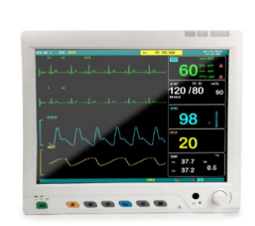

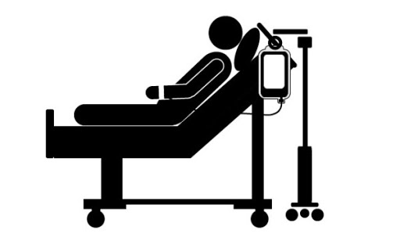



Motivation – Why non-contact vital signs detection?
Commercial vital sign (heart rate and respiration) detection systems traditionally wearable
Not feasible in all scenarios
Track vital signs of bed ridden patients to detect problems in breathing and sudden changes in heart rate
Even more important in case of burn victims and newborn babies
Applicable to numerous scenarios:
Track vital signs of drivers
Locating survivors in search and rescue missions

Slide 23


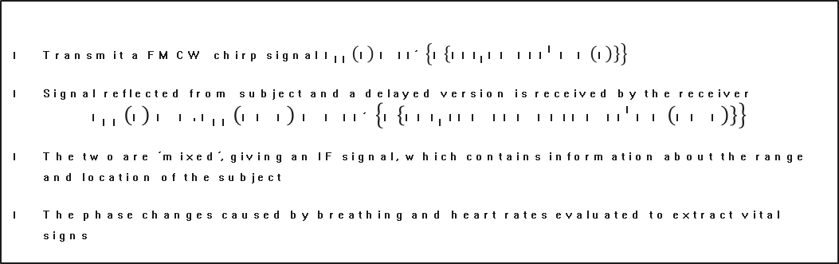
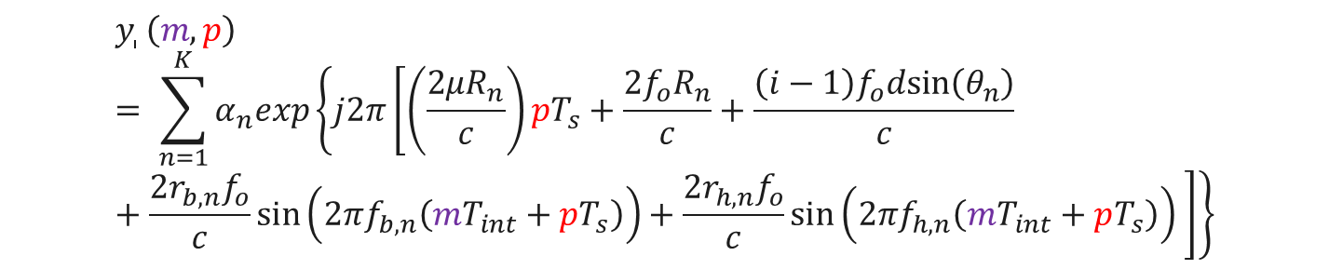
Vital Signs Detection Using FMCW Radars
FMCW Signal
Transmit a FMCW chirp signal$S_{Tx}\left(t\right)=\exp\left\{j \left\{2πf_{o}t+πμt^{2}+φ\left(t\right)\right\}\right\}$
Signal reflected from subject and a delayed version is received by the receiver
$$S_{Rx}\left(t\right)=B.S_{Tx}\left(t−τ\right)=B\exp\left\{j \left\{2πf_{o}(t−τ)+πμ{(t−τ)}^{2}+φ\left(t−τ\right)\right\}\right\}$$
The two are ‘mixed’, giving an IF signal, which contains information about the range and location of the subject
The phase changes caused by breathing and heart rates evaluated to extract vital signs
After ADC sampling, the IF signal at $i^{th}$ receive element is
Angle
$$y_{i}\left(m,p\right)= \sum_{n=1}^{K}{α_{n}exp\left\{j2π\left[\left(\frac{2μR_{n}}{c}\right)pT_{s}+\frac{2f_{o}R_{n}}{c}+\frac{\left(i−1\right)f_{o}dsin\left(θ_{n}\right)}{c}+\frac{{2r}_{b,n}f_{o}}{c}\sin\left(2πf_{b,n}\left(mT_{int}+pT_{s}\right)\right)+\frac{{2r}_{h,n}f_{o}}{c}\sin\left(2πf_{h,n}\left(mT_{int}+pT_{s}\right)\right) \right]\right\}}$$
Range
Breathing
Heartbeat

Slide 24
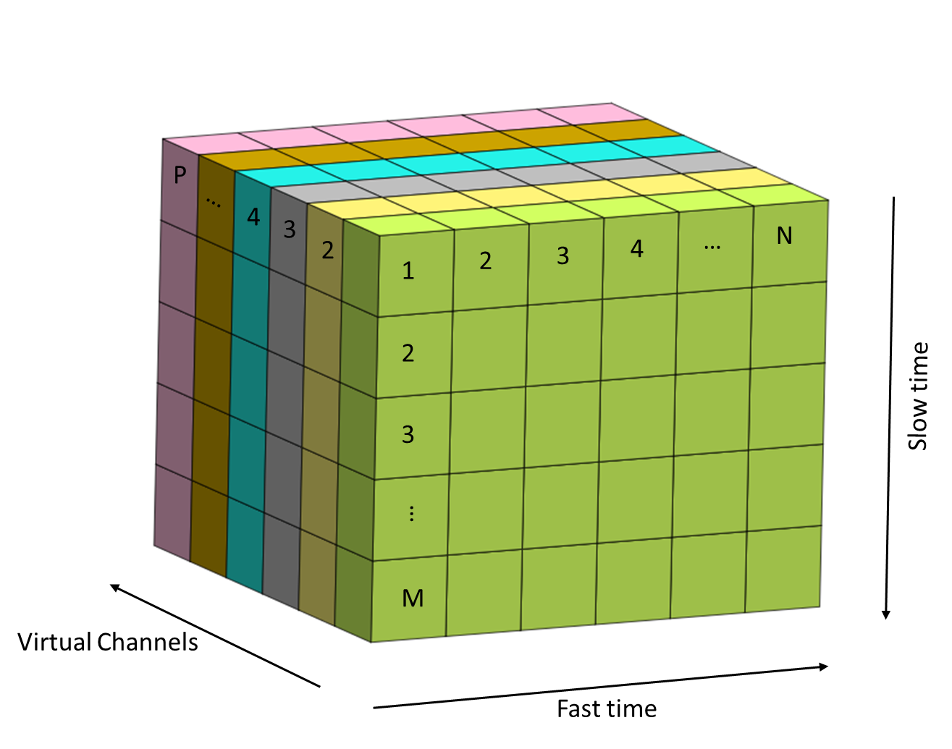

























Vital Signs Detection Using mmWave Radars
$$TDM Transmission Scheme$$
$${TX}_{1}$$
$$f$$
$${TX}_{2}$$
$$Frame 1$$
$$Frame 2$$
$$Frame M$$
$$t$$
$$T_{FRI}$$
$$Antenna Array Structure$$
Evaluation scheme
Single chirp samples (fast time) to resolve subject in range
Multi channel transmit and receive to resolve subject in angle (virtual channels)
Evaluate echo signal from subject across time (slow) to resolve vital signs
$${TX}_{1}$$
$${TX}_{2}$$
$${RX}_{1}$$
$${RX}_{2}$$
$${RX}_{3}$$
$${RX}_{4}$$
$$4d$$
$$d$$
$$d$$
$$d$$
$$x$$
$$Virtual Array$$
$$d$$
$$d$$
$$d$$
$$d$$
$$d$$
$$d$$
$$d$$
$$x$$

Slide 25
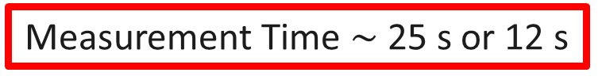
Vital Signs Detection: Pilot Studies
Parameter (FMCW) | Value
Number of Samples (fast time) | 128
Number of Frames (slow time) | 512 or 256
Frequency | 77 GHz
Bandwidth (BW) | 4 GHz
PRF (Slow Time) | 20 Hz
NRx antennas | 4
NTx antennas | 2
Measurement Time $\sim$ 25 s or 12 s

Slide 26
Detection Algorithm – Block Diagram
Select Data for Measurement Window
Static Clutter Removal
Range FFT
Select Range Peak and Adjacent Bins
Angle FFT
Extract, Unwrap and Diff Phase
Filter
DC Offset Correction
Extract Slow Time Signal
Select Angle Peak and Adjacent Bins
Doppler FFT
Extract Doppler Peaks
Generate Pseudo Spectrum By Peak Counting
Highest Occurring Peak assigned Heart Rate

Slide 27
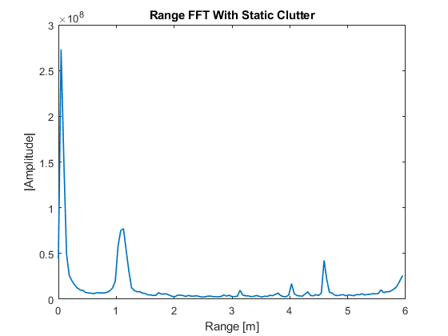
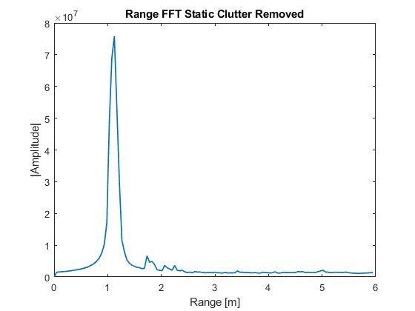
Detection Algorithm – Block Diagram
Select Data for Measurement Window
Static Clutter Removal
Range FFT
Select Range Peak and Adjacent Bins
Angle FFT
DC
Extract, Unwrap and Diff Phase
Filter
DC Offset Correction
Extract Slow Time Signal
Select Angle Peak and Adjacent Bins
Subject
Echoes from static clutter
Doppler FFT
Extract Doppler Peaks
Generate Pseudo Spectrum By Peak Counting
Highest Occurring Peak assigned Heart Rate
Subject

Slide 28
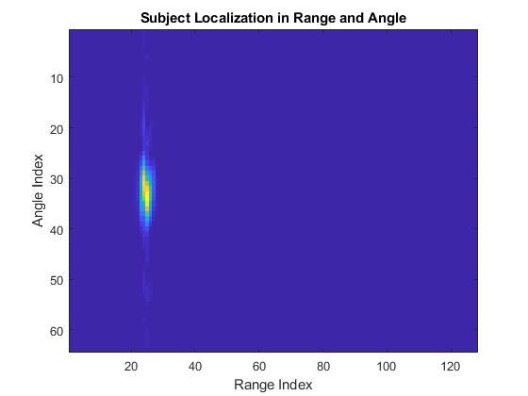
Detection Algorithm – Block Diagram
Select Data for Measurement Window
Static Clutter Removal
Range FFT
Select Range Peak and Adjacent Bins
Angle FFT
DC
Extract, Unwrap and Diff Phase
Filter
DC Offset Correction
Extract Slow Time Signal
Select Angle Peak and Adjacent Bins
Subject
Echoes from static clutter
Doppler FFT
Extract Doppler Peaks
Generate Pseudo Spectrum By Peak Counting
Highest Occurring Peak assigned Heart Rate
Subject
Subject Location

Slide 29
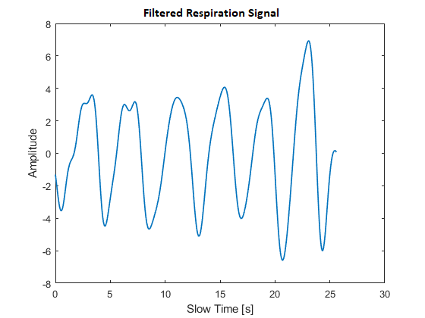
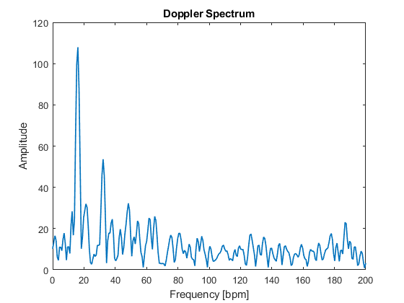
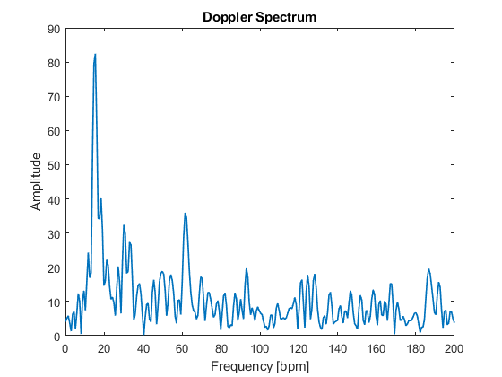
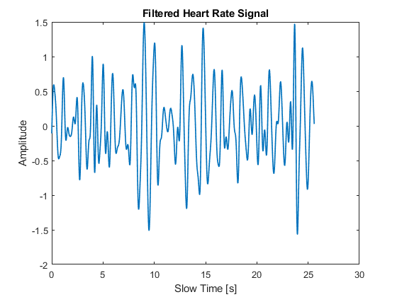
Detection Algorithm – Block Diagram
Select Data for Measurement Window
Static Clutter Removal
Range FFT
Select Range Peak and Adjacent Bins
Angle FFT
Respiration – Time Domain
0.1 – 0.8 Hz
Extract, Unwrap and Diff Phase
Filter
DC Offset Correction
Extract Slow Time Signal
Select Angle Peak and Adjacent Bins
Doppler FFT
Extract Doppler Peaks
Generate Pseudo Spectrum By Peak Counting
Highest Occurring Peak assigned Heart Rate
Heart – Time Domain
Respiration
Respiration
0.8 – 4 Hz
Heart Difficult to detect
Obvious Peaks For Respiration and Heart
Heart

Slide 30
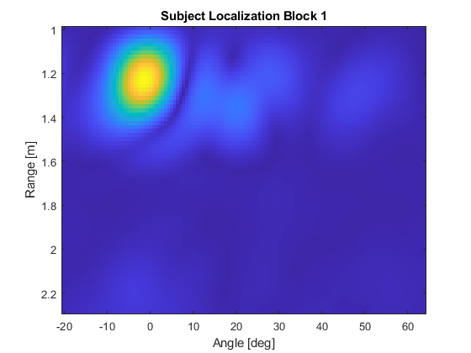
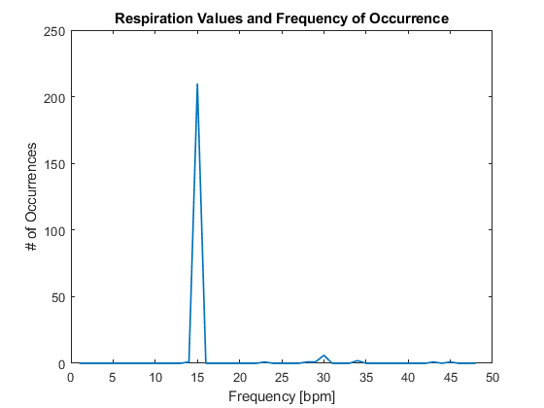
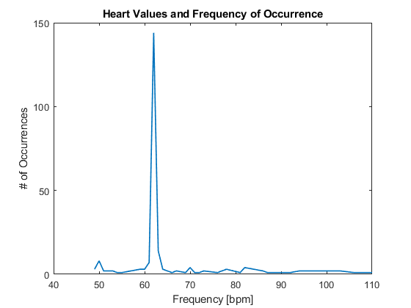
Detection Algorithm – Block Diagram
Select Data for Measurement Window
Static Clutter Removal
Range FFT
Select Range Peak and Adjacent Bins
Angle FFT
Select M range bins
(1)
Extract, Unwrap and Diff Phase
Filter
DC Offset Correction
Extract Slow Time Signal
Select Angle Peak and Adjacent Bins
Select N angle bins
(3)
(4)
(2)
Doppler FFT
Extract Doppler Peaks
Generate Pseudo Spectrum By Peak Counting
Highest Occurring Peak assigned Heart Rate
Respiration
Heart
Generated Pseudo Spectrum (Respiration Region)
Generated Pseudo Spectrum (Heart Region)
Actual Doppler Spectrum

Slide 31
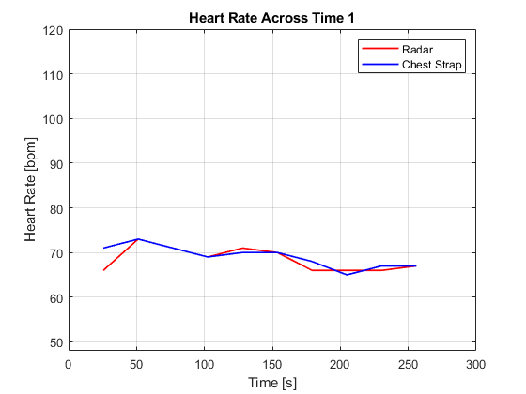
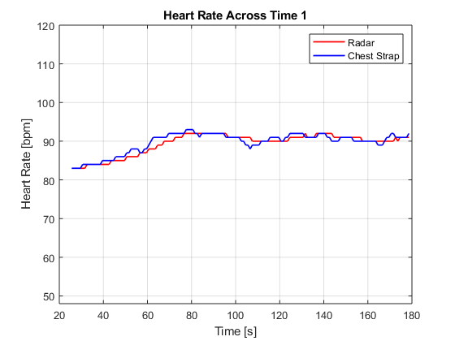
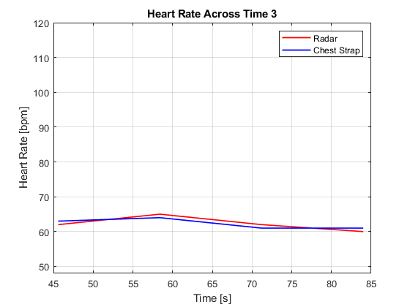
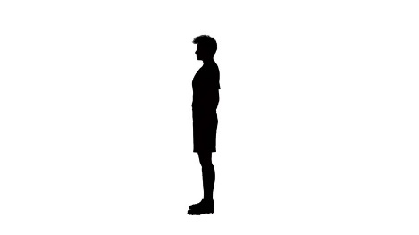




Vital Signs Detection – Validation Tracking Compared To Wearable Sensor
Laying Down
Sitting
Standing* – Forced Steady
Notes:
File June17_2020_2.bin

Slide 32
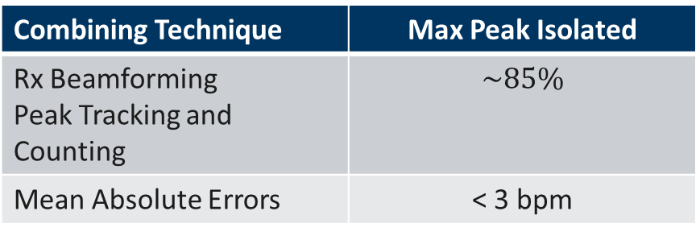
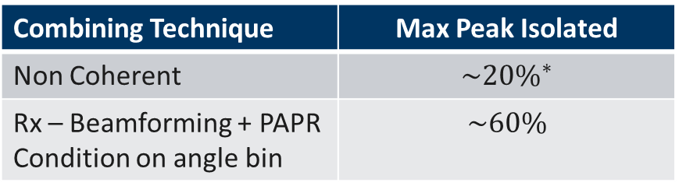
Summary of Pilot Studies
Combining Technique | Max Peak Isolated
Non Coherent | $$\sim 20\%^{∗}$$
Rx – Beamforming + PAPR Condition on angle bin | $$\sim 60\%$$
Current Problems
Motion corruption increases progressively from laying down to sitting to standing positions.
Artifacts of small scale body motion appear at vital sign frequencies.
Current Research
Time frequency analysis to resolve and remove effect of motion.
Use of focusing lens as a means to increase SNR and improve detection.
Goal
Make algorithm robust even against motion.
Combining Technique | Max Peak Isolated
Rx Beamforming Peak Tracking and Counting | $$\sim 85\%$$
Mean Absolute Errors | < 3 bpm

Slide 33

Dissemination Activities
Industry interactions
Monthly reviews with Texas Instruments
Project discussions with liaisons at TI
SRC Annual reports and publications
SRC e-seminars
TxACE talks
IEEE Special Issue on Automotive Radars
Conference presentations
Techcon submissions
Nominated for the best paper award in IEEE SP Magazine

Slide 34
Publications
M. Yanik, D. Wang and M. Torlak, “3-D MIMO-SAR Imaging Using Multi-Chip Cascaded Millimeter-Wave Sensors,” Proc. IEEE Globalsip Conf., Nov. 11-14, 2019, Ottawa, Canada.
M. Yanik, D. Wang and M. Torlak, "Development and Demonstration of MIMO-SAR mmWave Imaging Testbeds," IEEE Access, vol. 8, pp. 126019-126038, July 8, 2020.
J. W. Smith, M. Yanik, and M. Torlak, “Near-Field MIMO-ISAR Millimeter-Wave Imaging, Proc. IEEE Radar Conf., Sept. 21-25, 2020, Florence, Italy.
A. B. Baral and M. Torlak, “Joint Doppler Frequency and Direction of Arrival Estimation for TDM MIMO Automotive Radars,” IEEE Journal of Sel. Topics in Signal Proc., Sept. 2020, submitted.
Guest Editor, IEEE JSTSP Special Issue on Recent Advances in Automotive Radar Signal Processing

